Slide 1
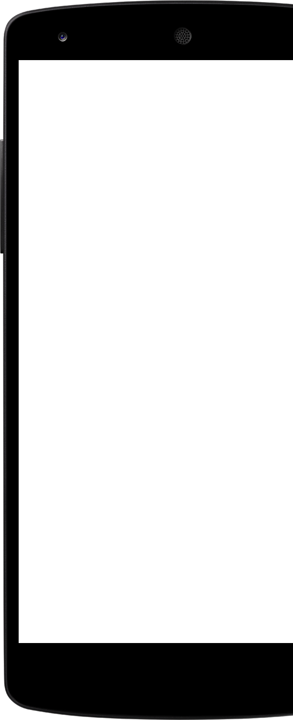
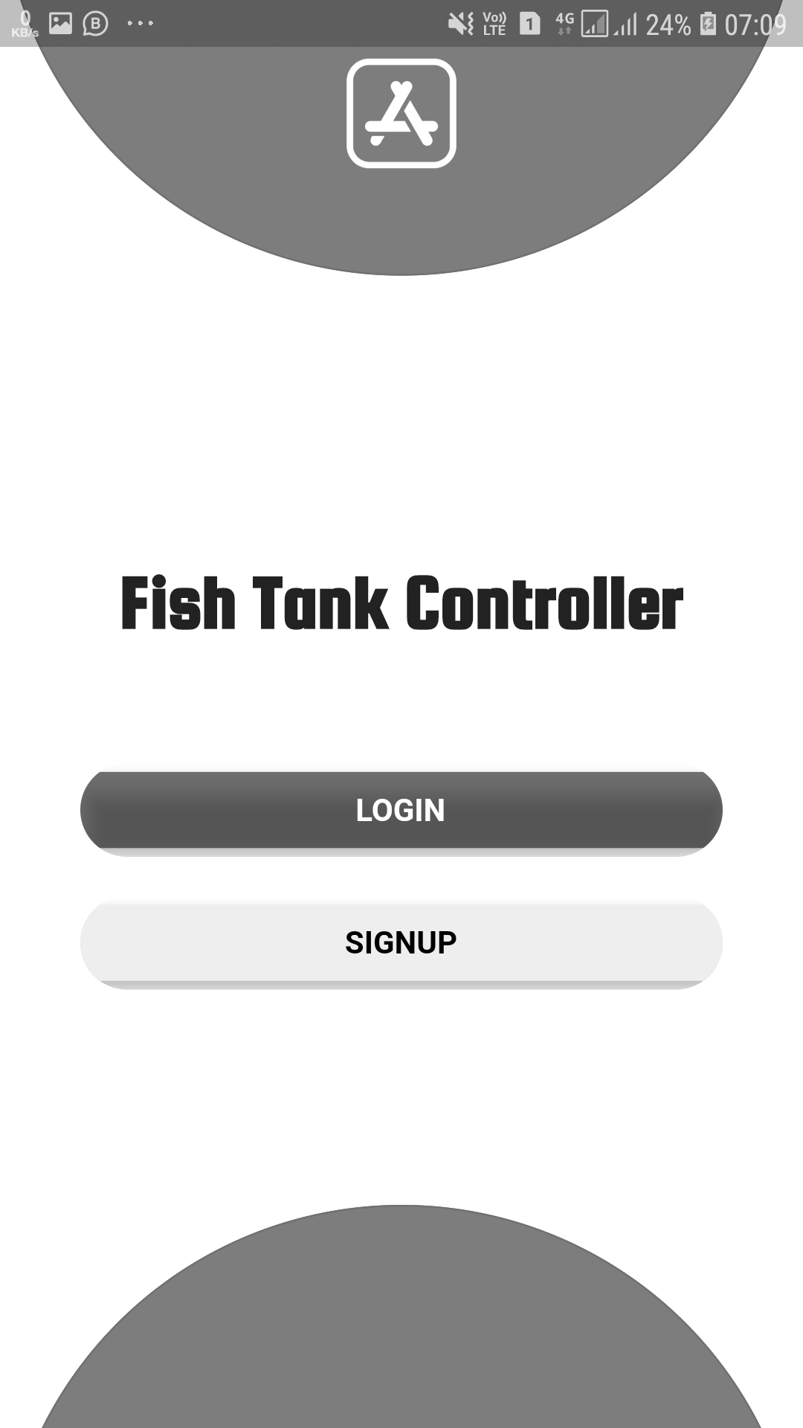
Fish Tank
Control System
MILESTONE 3
GROUP 4
E/16/377
E/16/332
E/16/127

Slide 2
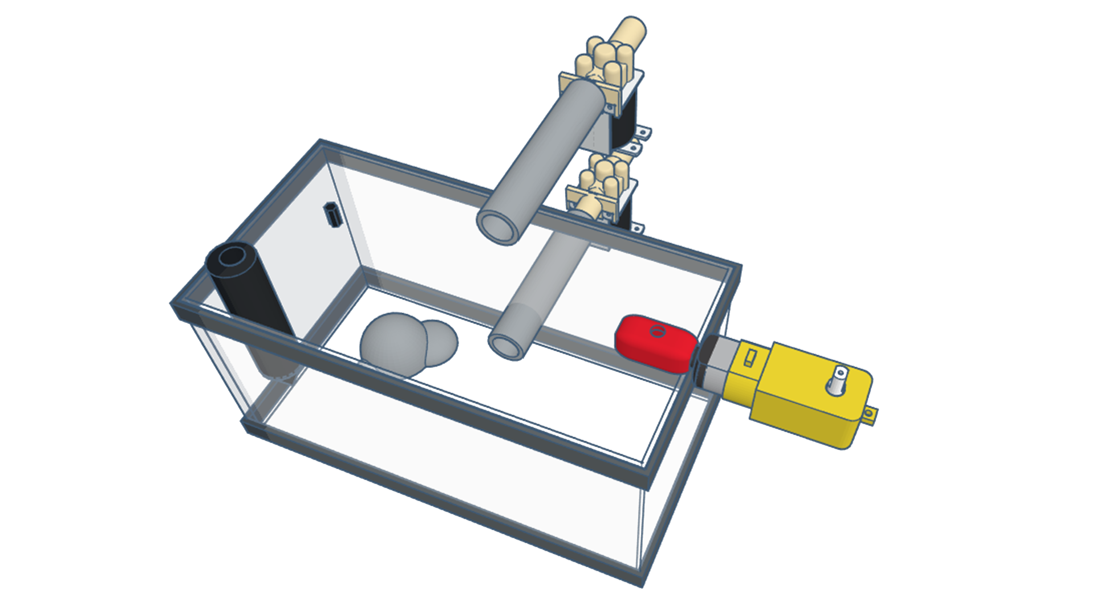
QUICK REVIEW
Control series of large scale fish tanks through the app.
Renewing water
Feeding Fish
Get Data (PH value, Temperature)

Slide 3

Milestone 3
Front-end software
Back-end software
Cloud deployment
Software testing

Slide 4
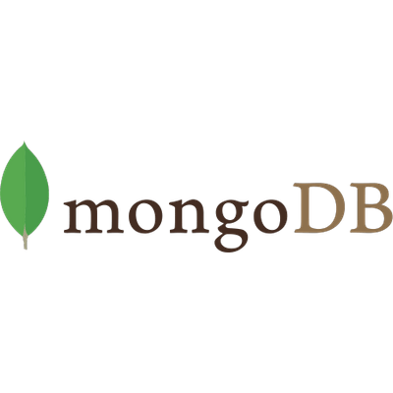
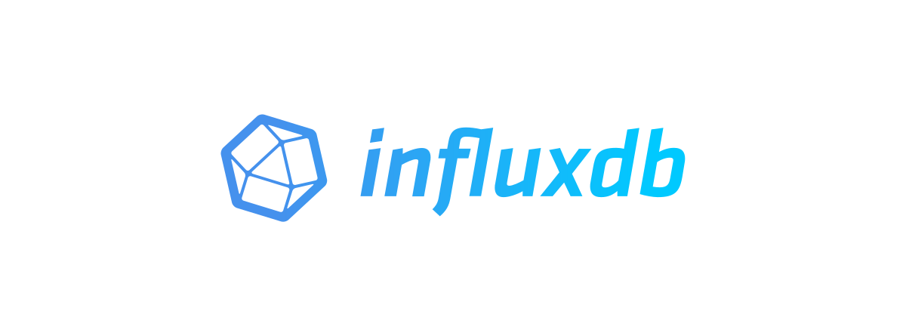

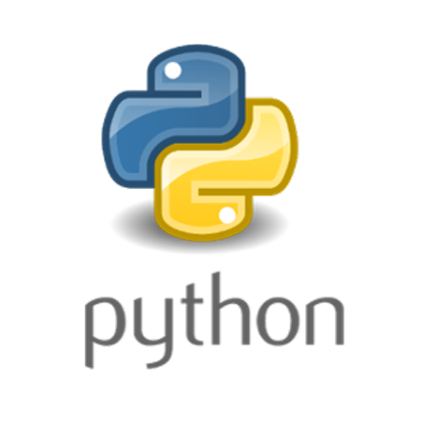
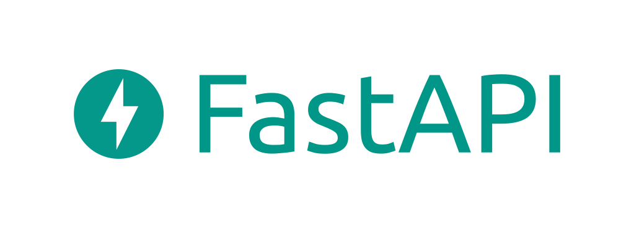
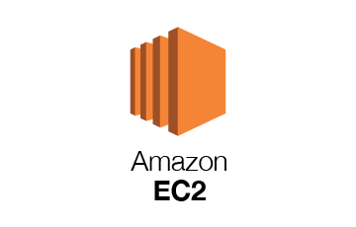

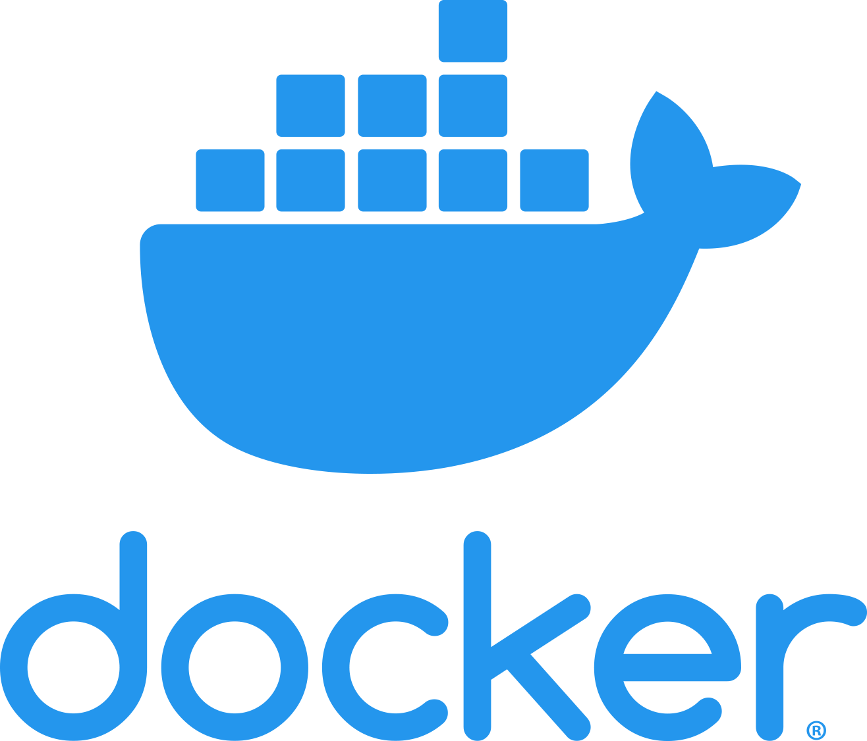
What we have used?
Mobile Application
Database
Back-end
Cloud

Slide 5

Security
Data validation
Auth-2.0 authorization
Password hashing
Rate limits
Pagination
SQL injection prevention

Slide 6

Scalability
Used Threading concurrency
Asynchronous function supporting
Can change the database structure easily without changing the database collection using mongodb.
New hardware devices can be added.

Slide 7

Reliability
Mobile friendly authentication
Responsive UI
Persistence sessions using tokens
Ability to work without electricity

Slide 8
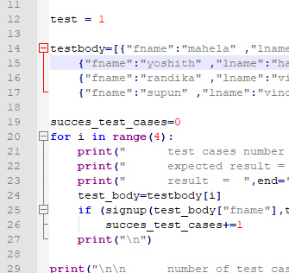
Testing
What is tested?
All the backend APIs
Graph testing
Why it is tested?
All the processes depends on backend APIs
Correctness of data
Testing the 3rd party libraries

Slide 9
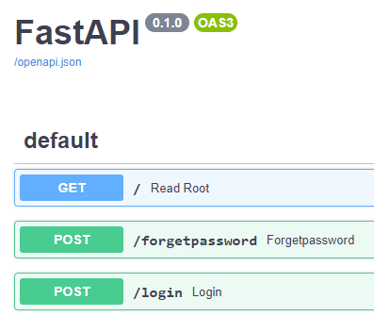
Testing
Errors we found at the beginning through testing
Database connectivity issue: Debugged by using an async function
JWT token error: Debugged by changing to the matching code format
All the errors were debugged and tested again using Integration testing.

Slide 10
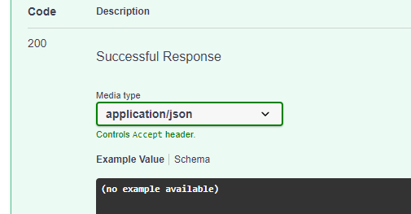
Testing
Test Results
forgetpassword | done
login | done
signup | done
changenames | done
changenames | done
changepassword | done
control/feed | done
control/renew | done
tankapi/error | done
tankapi/data | done
tankapi/feedtime | done
tankapi/temp | done
app/addtank | done
app/retrivedata | done
app/getdevicedata | done
app/fishnames | done
Individual units of program are combined and tested as a group
All the test cases were passed.

Slide 11
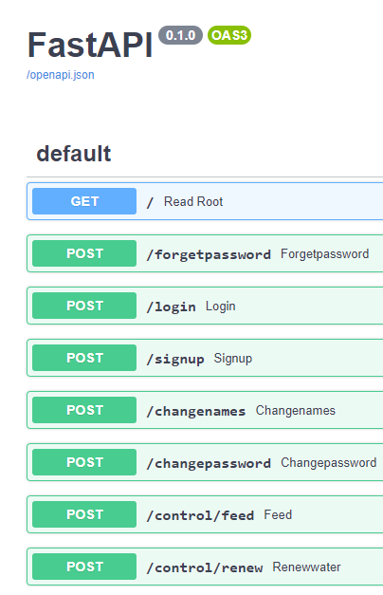
DEMONSTRATION
Testing

Slide 12
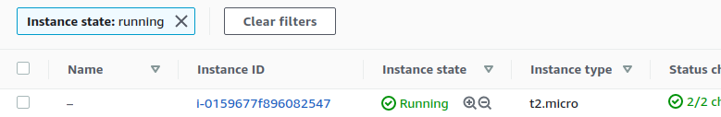
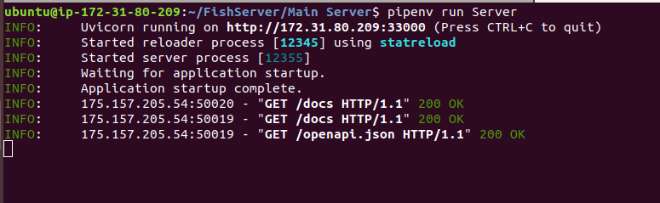
Cloud Deployment
1
EC2 instance is used
Databases are run on docker

Slide 13
DEMONSTRATION
Mobile App

Slide 14
Questions?

Slide 15


